Slide 1

SUPERVISED MACHINE LEARNING WITH RANDOM FORESTS
Notes:
Prompt: Forests of Random Forests

Slide 2
ENSEMBLE LEARNING
Combines multiple “weak learners” to create a stronger model that reduces error and improves generalization.
Bagging: Trains models on bootstrapped samples; combines predictions by averaging or voting → reduces variance, prevents overfitting.
Boosting: Sequentially corrects errors of prior models → reduces bias and variance for high accuracy.
Stacking: Combines diverse models using a meta-model that learns optimal blending → leverages strengths of all models.

Slide 3
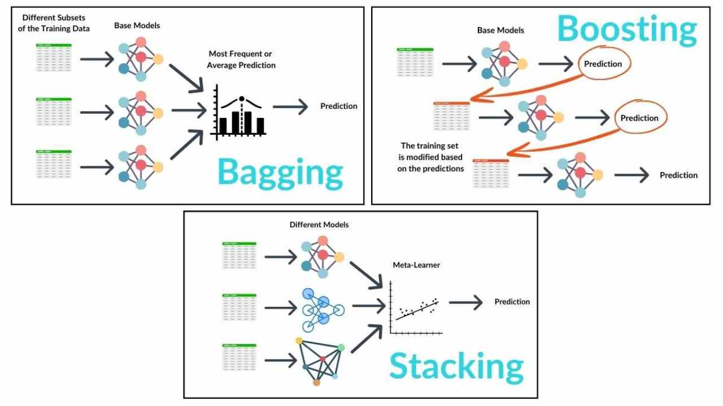
FLAVORS OF ENSEMBLE LEARNING: BAGGING, BOOSTING, STACKING

Slide 4
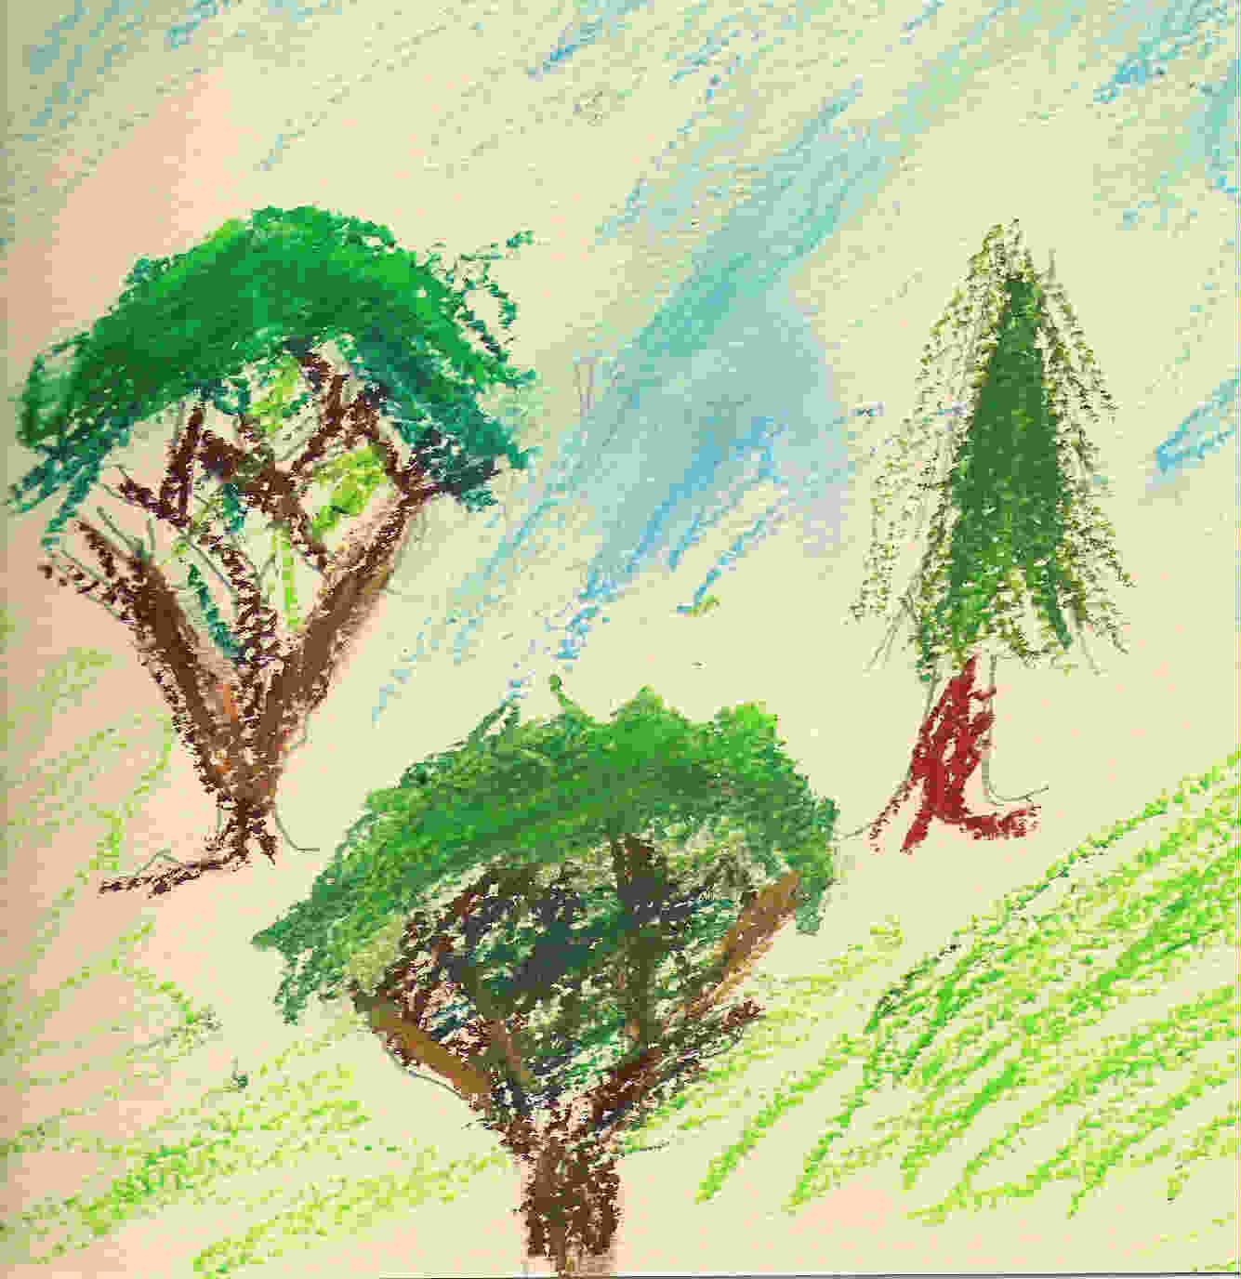
Random Forest
An ensemble of randomized CART decision trees.
Combining trees beneficial if uncorrelated.

Slide 5


Recall: CART Limitations
Cart
Random forests
High variance
Easy to overfit.
Decreased variance (ensembling)
Less sensitive to outliers

Slide 6
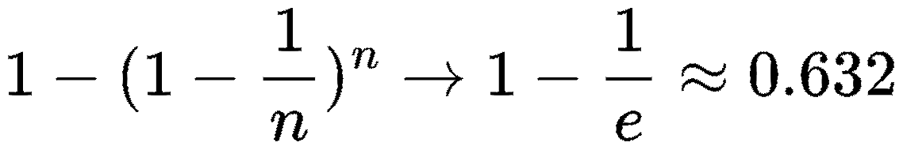
Random Forest Randomizations
Bootstrapping
Random Feature Selection
For each tree, data is sampled with replacement
Sampled data: In-bag
Otherwise: Out-of-bag
P(In-Bag) -->
At each split, m variables considered
For classification: m = sqrt(d)
For regression: m = (1/3)d

Slide 7

Out-of-Bag Points
OOB pts. unseen by about 37% of trees
Serval as an internal validation set.
Used to estimate generalization error.
Can serve as cross-validation for hyperparameter tuning

Slide 8
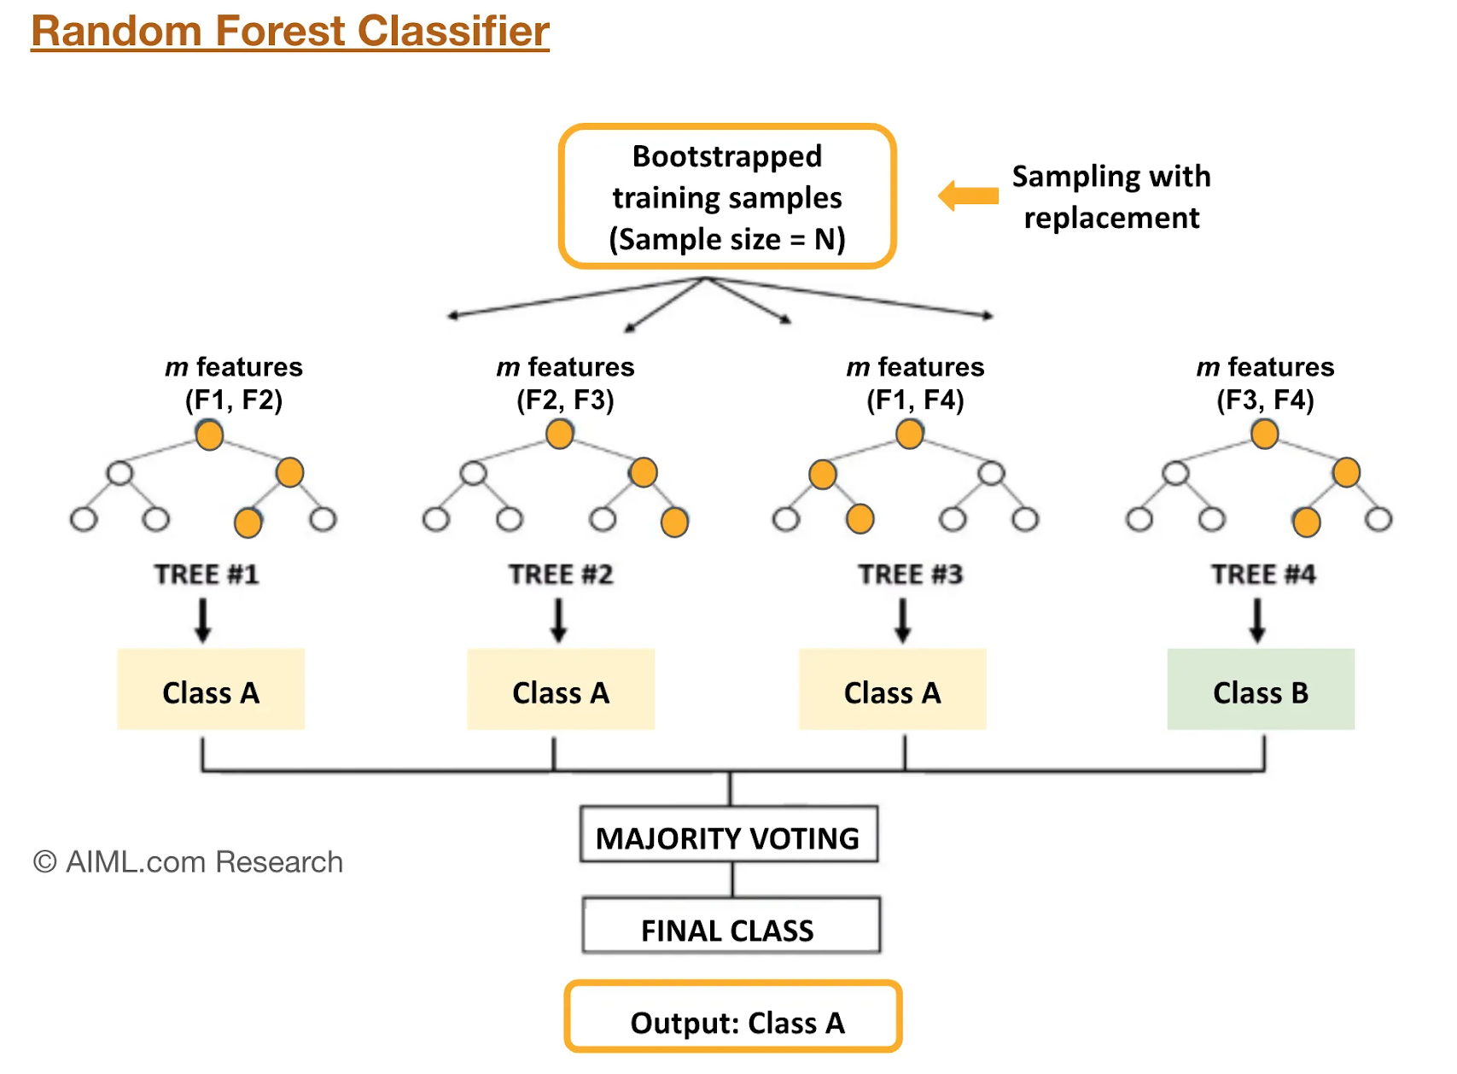
Random Forest Predictions
Each tree provides one vote
Unweighted majority voting
Averaging for regression

Slide 9
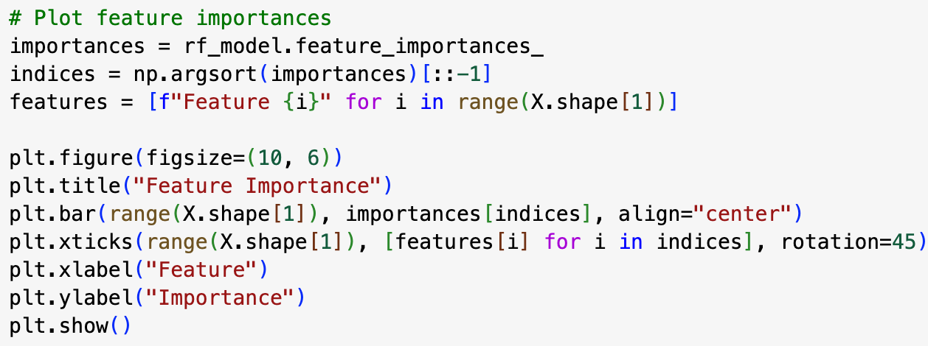
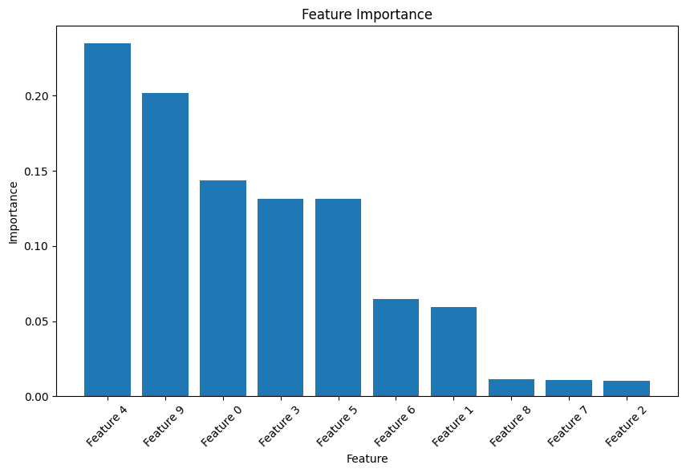
FEATURE IMPORTANCE
Two main methods to assess feature impact on predictions:
1. Mean Decrease in Impurity (MDI)
Default method; measures how much each feature reduces impurity (Gini/entropy).
Steps: compute impurity reduction → sum across trees → normalize.
Bias: favors features with many categories or continuous values.
2. Permutation Importance
Shuffles feature values to see how performance drops.
Steps: measure baseline → shuffle feature → re-evaluate → compute drop.
Interpretation: larger performance drop = more important feature.
Model-agnostic and less biased than MDI.

Slide 10
Random Forest Proximities
“[Proximities] are one of the most useful tools in random forests.”
--Leo Breiman
Original description:
“The proximities originally formed a NxN matrix. After a tree is grown, put all of the data, both training and oob, down the tree. If cases k and n are in the same terminal node increase their proximity by one. At the end, normalize the proximities by dividing by the number of trees.”
https://www.stat.berkeley.edu/~breiman/RandomForests/cc_home.htm#:~:text=few%20data%20sets.-,Proximities,by%20the%20number%20of%20trees.

Slide 11
Proximities in a Nutshell
“Proximities don’t just measure the similarity of the variables---they also take into account the importance of the variables.”
“Two cases that have quite different predictor variables might have large proximity if they differ only on variables that are not important.”
“Two cases that have quite similar values of the predictor variables might have small proximity if they differ on inputs that are important.”
--Adele Cutler

Slide 12
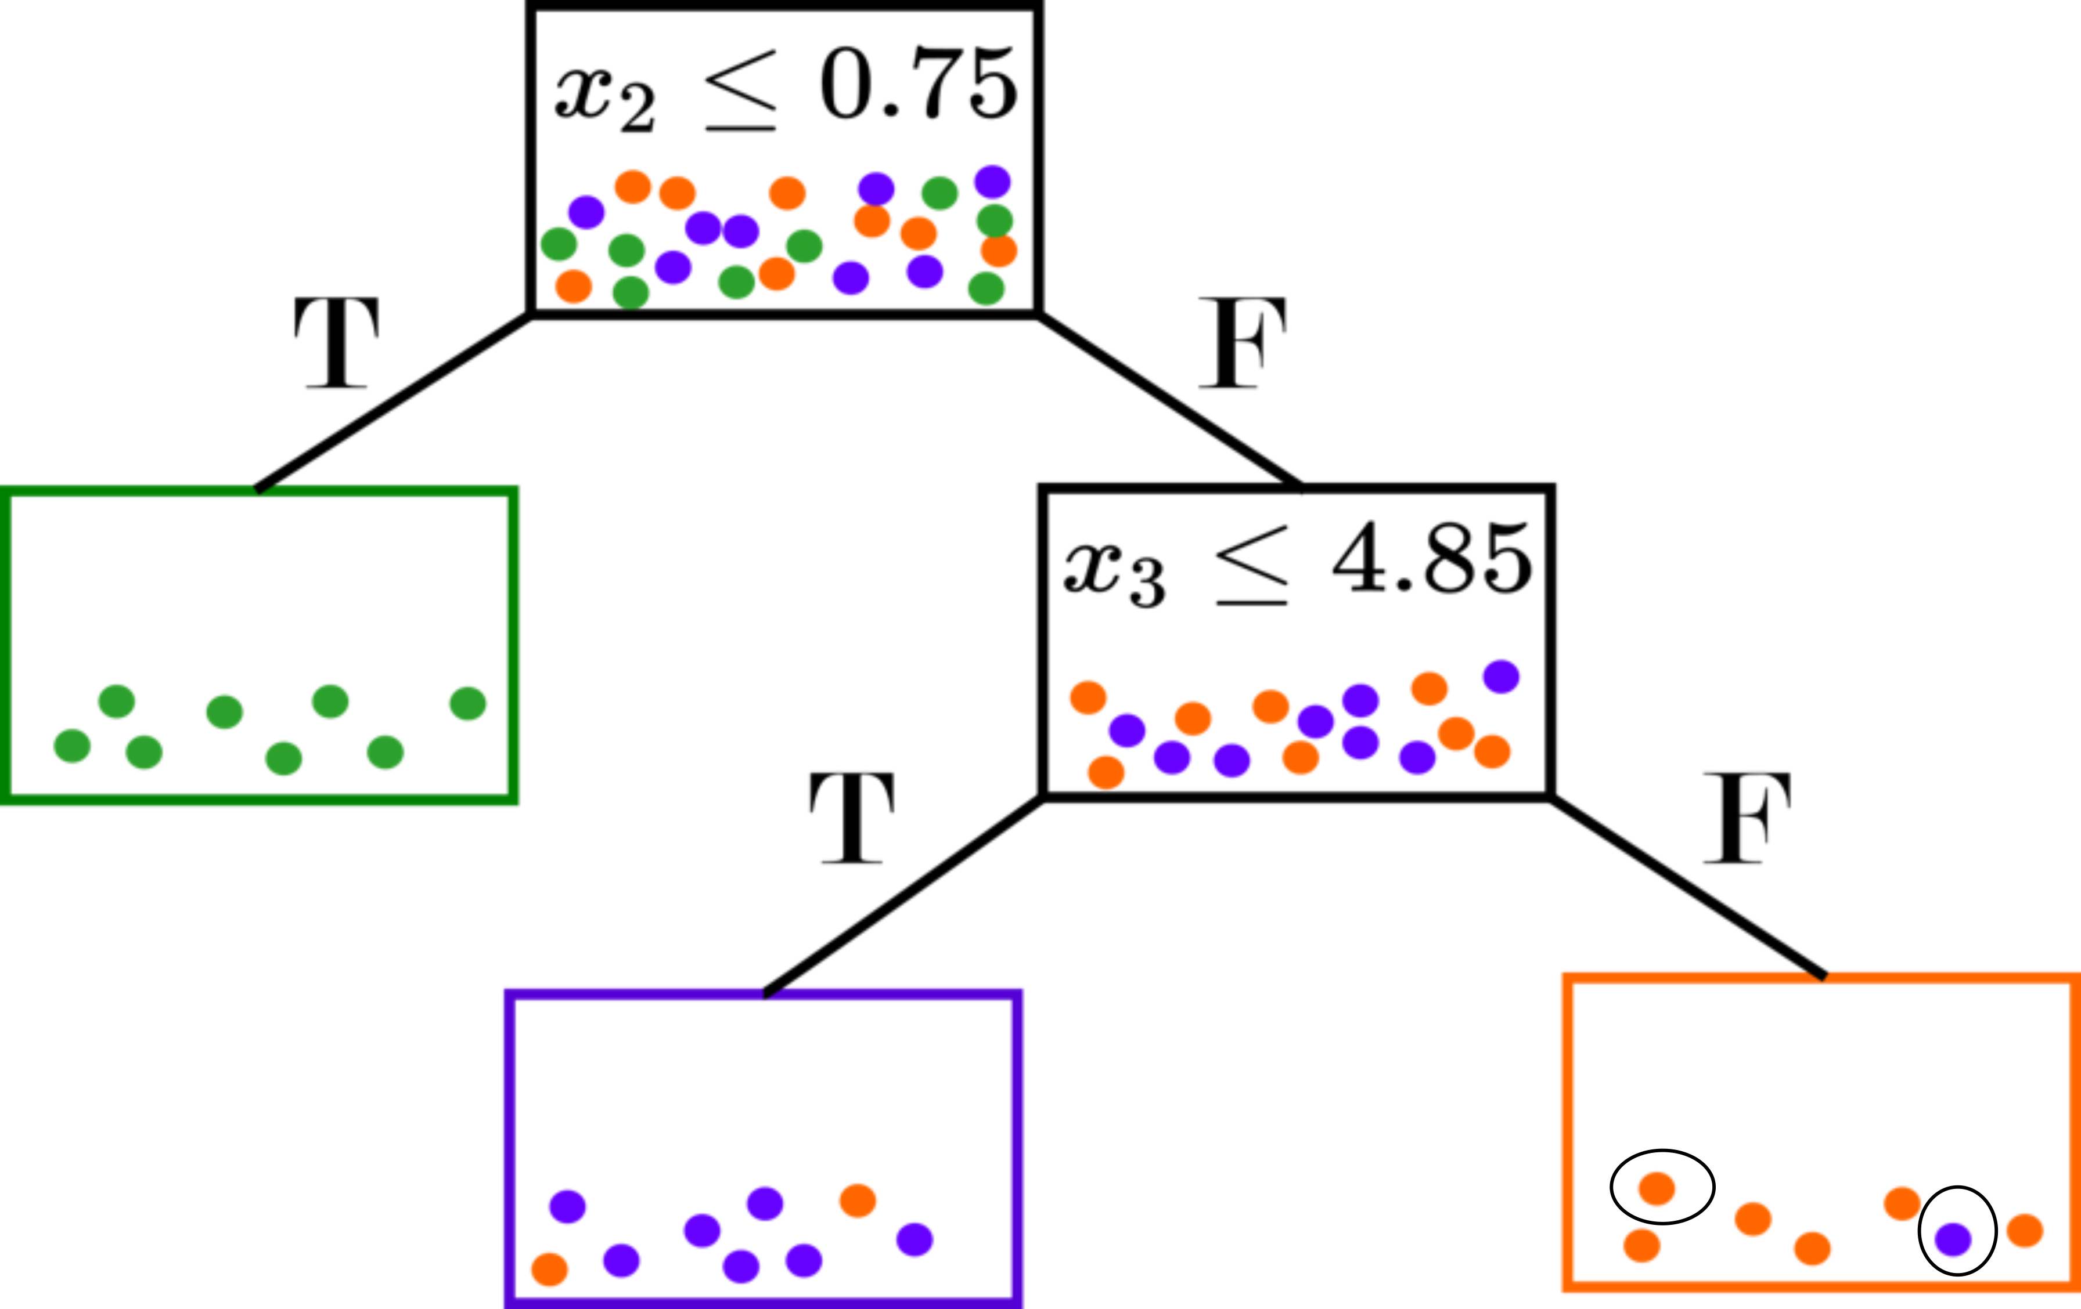
What are Random Forest Proximities
Proximities as a metric
A measure of “closeness”
Supervised, but not class-conditional
Based on splits (optimized over responses)
Natural incorporation of variable importance

Slide 13
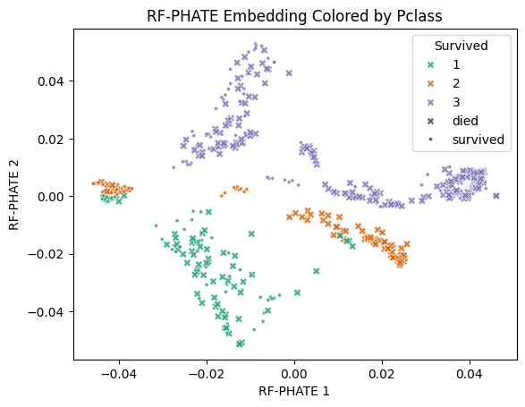
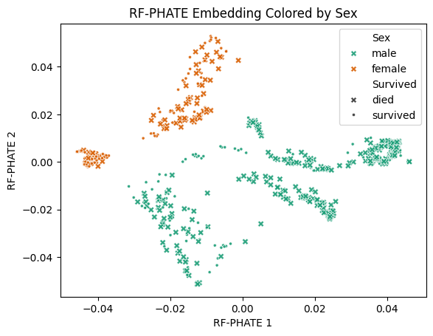
RF Proximities for Visualization
RF proximities visualizing the Titanic dataset

